Slide 1
a
Coupled binuclear copper (CBC) proteins
Hemocyanins
Polyphenol oxidases
O₂ transportation
Tyrosinases
Catechol oxidases
Aurone synthases
O-Aminophenol oxidases
”O-methoxy phenolases”
Mono- and diphenolase activity
Diphenolase activity
O-aminophenol oxidase activity
O-methoxy phenolase activity
Guaicyl
Hydroxyanilinase activity
Syringyl
b
Monophenolase
(Monooxygenase)
Diphenolase
(2e⁻ oxidation)

Slide 2
a
b
c
d
e
f
g
h
i
j
k
l

Slide 3
a
b
c
d
e
f
g
h
i
j
k
l

Slide 5
Phylum
Species

Slide 6
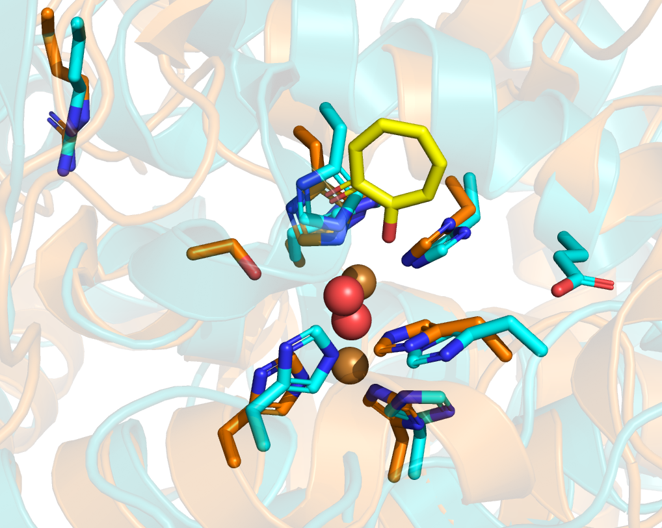
a
Cu_{A} binding motif
Waterkeeper residue
Cu_{B} binding motif
1st activity controller
Seventh histidine
b
Arg-239
Arg-200
2y9x (AbTyr, type c)
Tropolone
4J3P (AoCO4, type h)
Ser-302
Glu-256

Slide 7

Cu_{A} binding motif
Cu_{B} binding motif

Slide 9
Phylum
Class
Order
Species

Slide 10
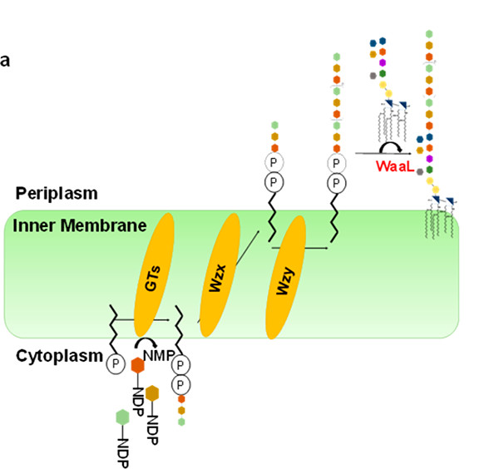

Slide 11
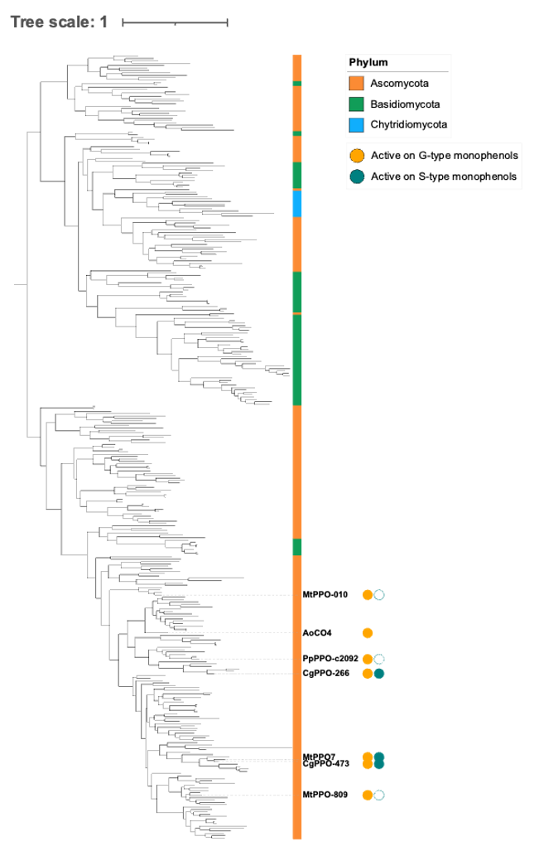

Slide 12
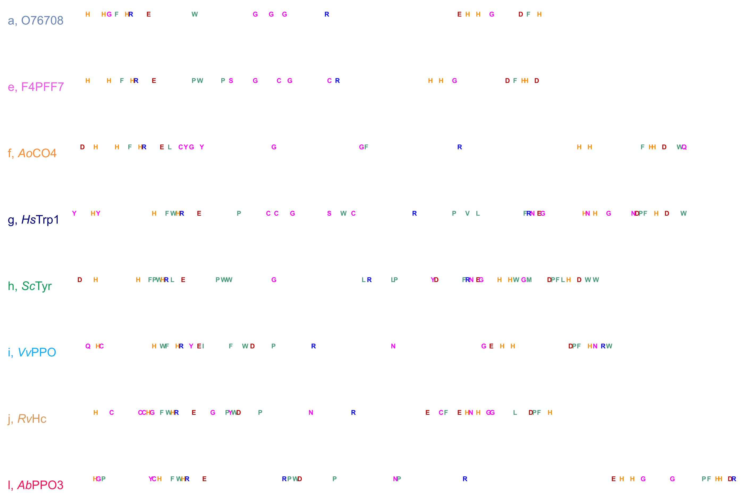
a
Cu_{A} binding motif
Cu_{B} binding motif
b
Arg-239
Arg-200
2y9x (AbTyr, type l)
Tropolone
4J3P (AoCO4, type f)
Ser-302
Glu-256

Slide 13
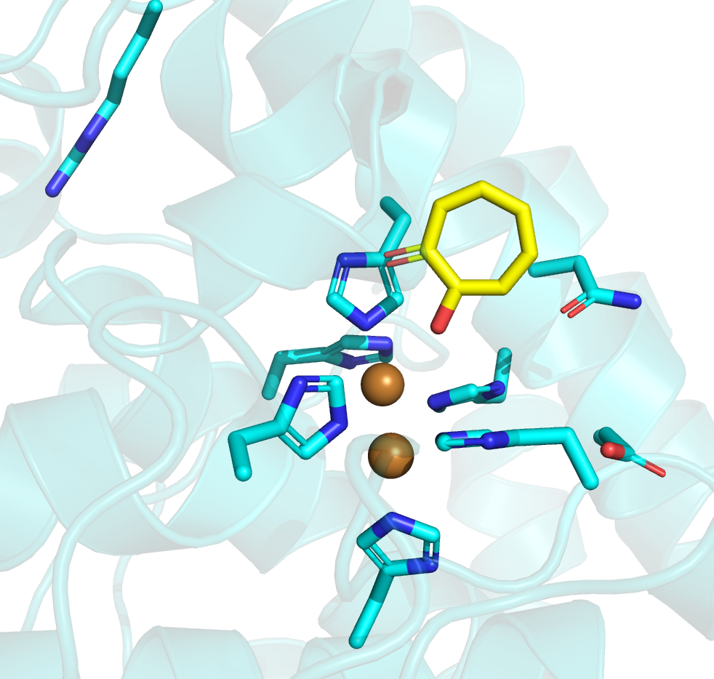
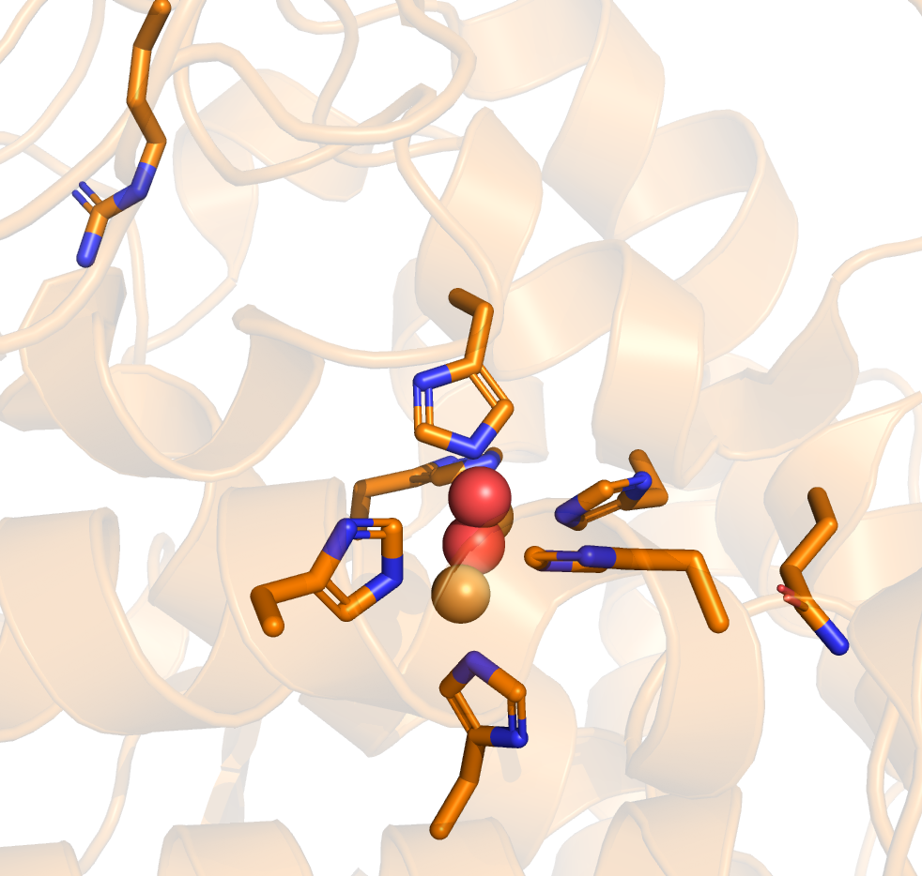
a
Cu_{A} binding motif
Cu_{B} binding motif
b
c
Arg-239
Arg-200
Tropolone
Asn-260
Gln-273
Glu-256

Slide 14
a
Cu_{A} binding motif
Cu_{B} binding motif
b
Arg-239
Arg-200
2y9x (AbTyr, type l)
Tropolone
4J3P (AoCO4, type f)
Ser-302
Glu-256

